Slide 1

SUB METER BILL GENERATOR
Morente, Jerald M.

Slide 2


SUB METER BILL GENERATOR
This android application is ideal for business apartments which are using electricity or water sub meter.

Slide 3
GENERAL PURPOSE
To easily calculate sub meters total consumption and to send the bill notice to the tenant immediately after reading their sub meters.

Slide 4
TECHNOLOGY STACK TO BE USED
Programming Language: Java
IDE: Android Studio
API: SmsManager API
ContactPicker API
Fingerprint API

Slide 5
FEATURES OF THE SYSTEM
Can select Billing type
Can calculate sub meters total consumption
Can set price per kWh/cubic
Send the record data via SMS to the tenant

Slide 6
SECURITY FEATURE
Fingerprint Authentication.
Back-up generated SMS notice as txt file.

Slide 7
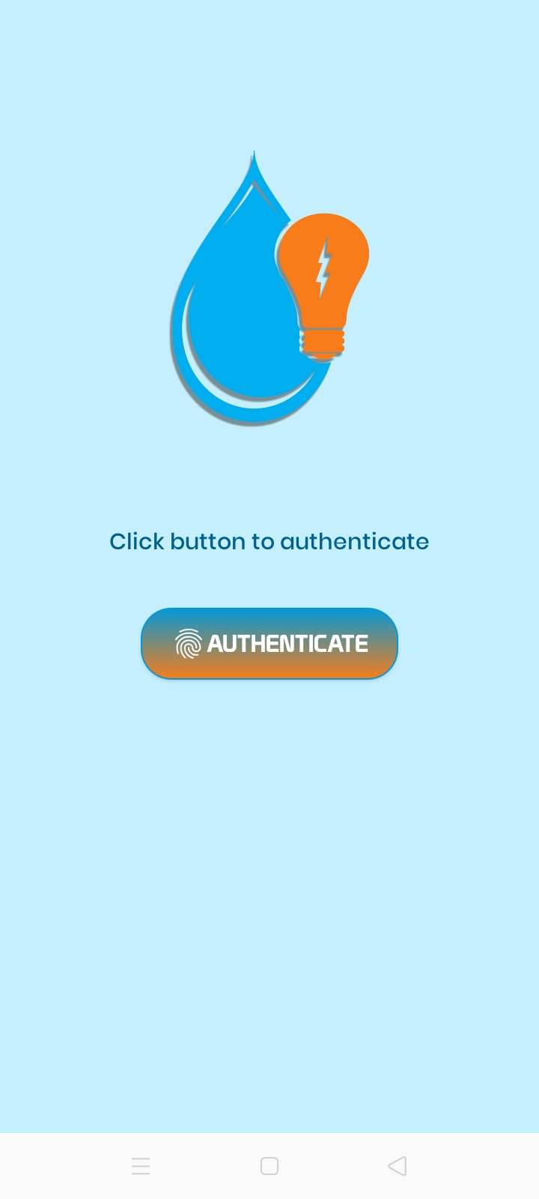
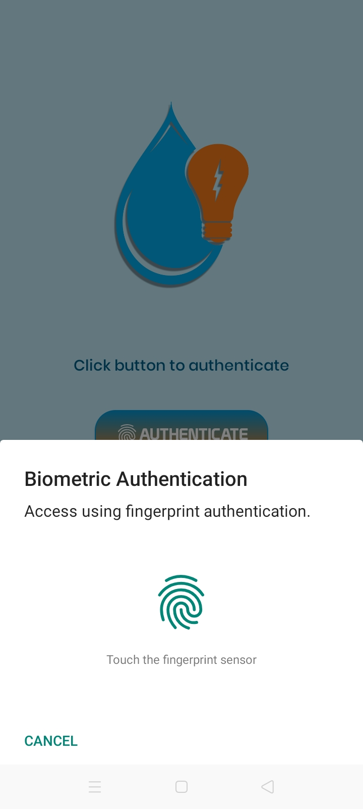
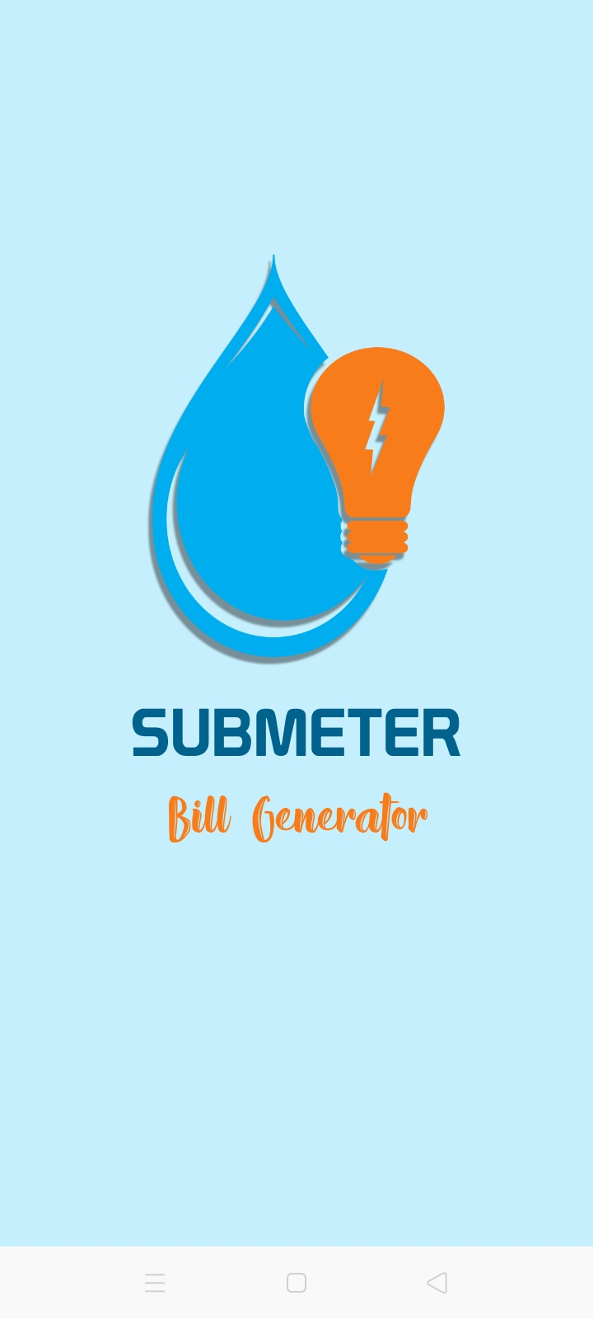
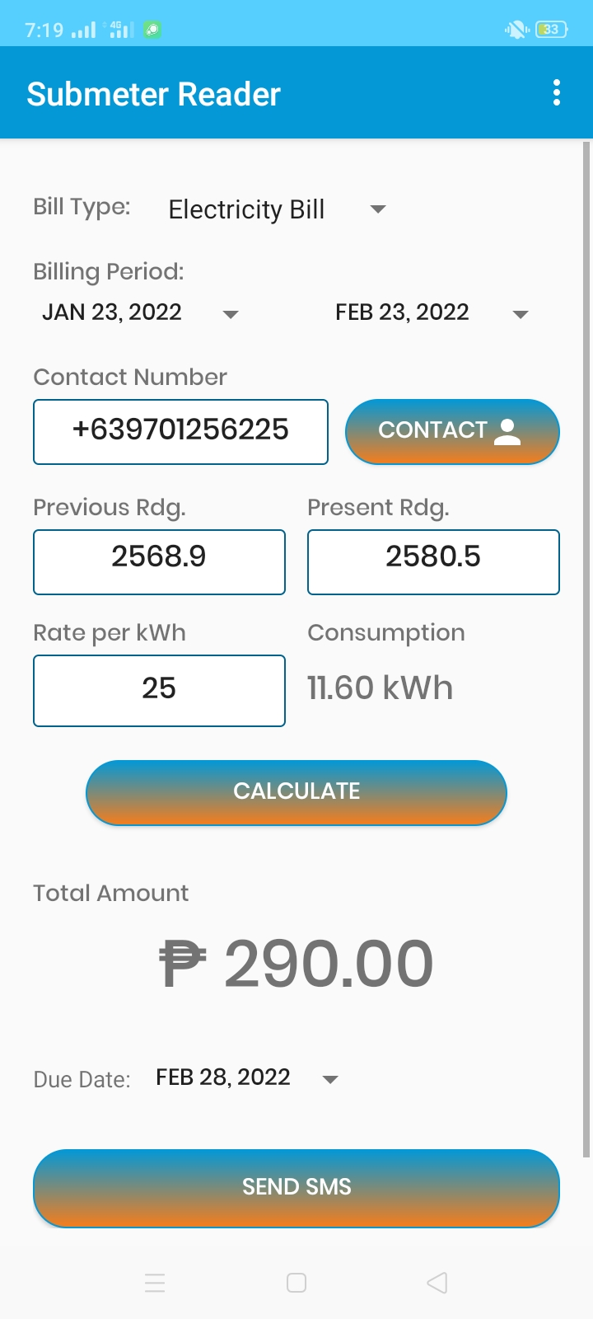
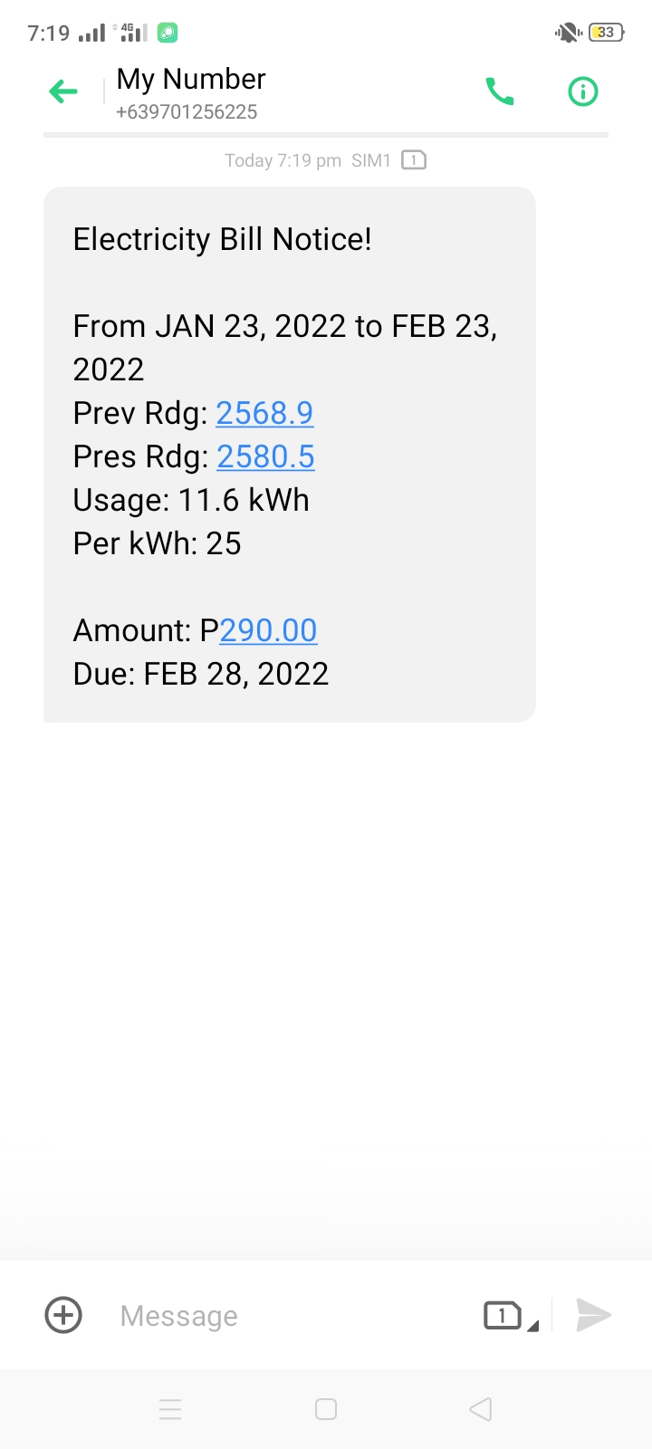
APPLICATION OUTPUT

Slide 8
REFERENCES
Android Coding. (2021, January 17). How to Send Message in Android Studio | SendMessage | Android Coding [Video]. YouTube. https://youtu.be/oP6D3q35Mmk
KDTechs. (2020, March 13). How to Pick and Display Phone Number From Contact List in Android [Video]. YouTube. https://youtu.be/EnVTJ7SUHlk
Pervaiz, A. [Atif Pervaiz]. (2018, June 23). Input Text and Save to Text file – Android Studio Tutorial [Video]. YouTube. https://youtu.be/I1fLQxdxdk4
Pervaiz, A. [Atif Pervaiz]. (2020, October 11). Biometric Authentication | Android Studio | Java [Video]. YouTube. https://youtu.be/yPcxZWSszh8

Slide 9



THANK YOU!
cv
cv
Prof. Ariel Tomagan
HCI 102: TECHNOPRENEURSHIP/ E-COMMERCE

